Slide 1
Propositional Logic
By: Dr. Sarmad Sadik

Slide 2
Foundations of Logic
Logic is a tool for working with complicated compound statements. It includes:
A language for expressing them.
A concise notation for writing them.
A methodology for objectively reasoning about their truth or falsity.
It is the foundation for expressing formal proofs in all branches of mathematics.

Slide 3
Foundations of Logic: Overview
Propositional logic:
Basic definitions.
Equivalence rules & derivations.
Predicate logic:
Predicates.
Quantified predicate expressions.
Equivalences & derivations.

Slide 4
Propositional Logic
Good notation greatly facilitates clear thinking, intuition, and insight. It removes the irrelevant to help us see true relationships that would otherwise be invisible
Good manipulation skills allow us to proceed from one conclusion to the next quickly, confidently, and verifiably.

Slide 5
The Real World
Follows
Semantics
Semantics
Model
Entails
Sentences
Sentence
Syntax
Syntax
Symbols
Derives
Symbol String
Symbol Strings

Slide 6
Propositional Logic
Propositional Logic is the logic of compound statements built from simpler statements using Boolean connectives.
Basic Applications:
Design of digital electronic circuits.
Expressing conditions in programs.
Queries to databases & search engines.

Slide 7
Propositional Logic
A proposition (p, q, r, …) is simply a statement (i.e., a declarative sentence) with a definite meaning, having a truth value that’s either true (T) or false (F) (never both, neither, or somewhere in between).
[In probability theory, we assign degrees of certainty to propositions.] i.e.
“It is raining.” (Given a situation.)
“Beijing is the capital of China.”
“1 + 2 = 3”
“Who’s there?”
Jim is a Vegetarian.
It is raining.
Asad likes biscuits.
“Just do it!”
“1 + 2”
These are not
Propositions

Slide 8
Truth Values
Every Proposition may be associated with a truth value.
In propositional logic there are two possible truth values
that is True or False.
The truth value of a proposition may change
according to when it is stated.

Slide 9
Truth depends on Interpretation
Representation 1 World
A
B
ON(A,B) T
ON(A,B) F
ON(A,B) F A
ON(A,B) T B

Slide 10
Operators / Connectives
An operator or connective combines one or more operand expressions into a larger expression. (E.g., “+” in numeric expressions.)
Unary operators take 1 operand (e.g., -3); binary operators take 2 operands (e.g. 3 × 4).
Propositional or Boolean operators operate on propositions or truth values instead of on numbers.

Slide 11
The Negation Operator
The unary negation operator “¬” (NOT) transforms a
prop. into its logical negation.
If p = “I have brown hair.”
then ¬p = “I do not have brown hair.”

Slide 12
Negation of p
Let p be a proposition. The statement “It is not the case that p” is also a proposition, called the “negation of p” or ¬p (read “not p”).
p = The sky is blue.
¬p = The sky is not blue.
The Truth Table for the
Negation of a
Proposition
p ¬p
T F
F T

Slide 13
Negation
For any proposition
(¬¬p) ⇔ p
(¬¬true) ⇔ true
(¬¬false) ⇔ false

Slide 14
Simple Exercise
Calculate the truth values of following propositions
¬(0<1)
¬(1+1=2)
¬(The earth revolves around the moon)

Slide 15
Conjunction Operator
The binary conjunction operator “∧” (AND) combines two propositions to form their logical conjunction.
If
p=“I will have salad for lunch.”
q=“I will have steak for dinner.”
then
p∧q=“I will have salad for lunch and I will have steak for dinner.”

Slide 16
Conjunction of p and q
The Truth Table for the Conjunction of two propositions
Let p and q be propositions.
The proposition “p and q,”
denoted by p∧q is true when
both p and q are true and is
false otherwise This is called
the conjunction of p and q.
p q p∧q
T T T
T F F
F T F
F F F

Slide 17
Conjunction
Example 1:
The conjunction of “Ali is a vegetarian”,
denoted by v and “Ali eats chocolate” ,
denoted by c,is written as v∧c.
Example 2:
The statement 0<1 ∧1<0 is false.

Slide 18
Truth Table
The truth table for p∧(¬q)
p | q | ¬q | p∧(¬q)
True | True | False | False
True | False | True | True
False | True | False | False
False | False | True | False

Slide 19
The Disjunction Operator
The binary disjunction operator “∨” (OR) combines two propositions to form their logical disjunction.
p=“That car has a bad engine.”
q=“That car has a bad carburetor.”
p∨q=“Either that car has a bad engine, or that car has a bad carburetor.”

Slide 20
Disjunction of p and q
Let p and q be propositions.
The proposition “p or q,” denoted by p∨q, is the proposition that is false when p and q are both false and true otherwise.
The Truth Table for the Disjunction of two propositions
p q p∨q
T T T
T F T
F T T
F F F

Slide 21
Disjunction of p and q
p | q | ¬p | ¬q | (¬p) ∨(¬q)
True | True | False | False | False
True | False | False | True | True
False | True | True | False | True
False | False | True | True | True

Slide 22
The Exclusive Or Operator
The binary exclusive-or operator “⊕” (XOR) combines two propositions to form their logical “exclusive or”
p = “I will earn an A in this course,”
q = “I will drop this course,”
p ⊕ q = “I will either earn an A for this course, or I will drop it (but not both!)”

Slide 23
Exclusive or of p and q
Let p and q be propositions.
The exclusive or of p and q, denoted by p⊕q, is the proposition that is true when exactly one of p and q is true and is false otherwise.
The Truth Table for the Exclusive OR of two propositions
p q p⊕q
T T F
T F T
F T T
F F F

Slide 24
The Implication Operator
The implication p → q states that p implies q.
It is FALSE only in the case that p is TRUE but q is FALSE.
E.g.
p=“A ball is shot.”
q=“The runs are made.”
p → q = “If ball is shot then runs are made” (else it could go either way)

Slide 25
Implication p→q
Let p and q be propositions.
The implication p→q is the proposition that is false when p is true and q is false, and true otherwise. In this implication p is called the hypothesis (or antecedent or premise) and q is called the conclusion(or consequence).
The Truth Table for the Implication of p→q.
p q p→q
T T T
T F F
F T T
F F T

Slide 26
Implications
If p, then q
p implies q
if p,q
p only if q
p is sufficient for q
q if p
q whenever p
q is necessary for p

Slide 27
Related Implications
Converse of
p → q
is
q → p
Contrapositive of
p → q
is the proposition
¬q → ¬p

Slide 28
Examples of Implications
“If this lecture ends, then the sun will rise tomorrow.” True or False?
“If Tuesday is a day of the week, then week has 8 days.” True or False?

Slide 29
Biconditional Equivalence
Let p and q be propositions.
The bi-conditional p↔q is the proposition that is true when p and q have the same truth values and is false otherwise. “p if and only if q, p is necessary and sufficient for q”.
The Truth Table for the bi-conditional p↔q.
p q p↔q
T T T
T F F
F T F
F F T

Slide 30
Simple Exercise
p: You learn the simple things well.
q: The difficult things become easy.
You do not learn the simple things well.
If you learn the simple things well then the difficult things become easy.
If you do not learn the simple things well, then the difficult things will not become easy.
The difficult things become easy but you did not learn the simple things well.
You learn the simple things well but the difficult things did not become easy.

Slide 31
Solution: Simple Exercise
p: You learn the simple things well.
q: The difficult things become easy.
You do not learn the simple things well.
If you learn the simple things well then the difficult things become easy.
If you do not learn the simple things well, then the difficult things will not become easy.
The difficult things become easy but you did not learn the simple things well.
You learn the simple things well but the difficult things did not become easy.
¬p
q ∧ ¬p
p→q
p ∧ ¬q
¬p → ¬q

Slide 32
Assignment 1
Write any seven rules each from three games which you like in formal notation using propositional logic.
Deadline: 18th Feb, 2013

Slide 33
Logical Equivalence
An important technique in proofs is to replace a statement with another statement that is “logically equivalent.”
Tautology: compound proposition that is always true regardless of the truth values of the propositions in it.
Contradiction: Compound proposition that is always false regardless of the truth values of the propositions in it.

Slide 34
Tautologies and Contradictions
A tautology is a compound proposition that is true no matter what the truth values of its atomic propositions are.
Ex. p ∨ ¬p
A contradiction is a comp. prop. that is false no matter what!
Ex. p ∧ ¬p
Other compound propositions are contingencies.

Slide 35
Simple Exercise
Determine using truth table whether the following propositions are tautologies, contradiction, or contingencies.
(p ∧ q) ∨ (¬ (p ∧ q ))
(p →q) ⇔ (¬ q → ¬ p)
(¬ p →q) →(p → ¬ q )
¬ (p →p) ∧ (¬ p → ¬ p)

Slide 36
Solution
(p →q) ⇔ (¬ q → ¬ p)
p | q | p → q | ¬ q → ¬ p | (p →q) ⇔ (¬ q → ¬ p)
True | True | True | True | True
True | False | False | False | True
False | True | True | True | True
False | False | True | True | True
Every entry in the final column is true so the proposition is a tautology.

Slide 37
Solution
(¬ p →q) →(p → ¬ q )
p | q | ¬ p → q | p → ¬ q | (¬ p →q) →(p → ¬ q )
True | True | True | False | False
True | False | True | True | True
False | True | True | True | True
False | False | False | True | True
There is one false entry and three true entries in the final column so it is a contingency.

Slide 38
Solution
¬ (p →p) ∧ (¬ p → ¬ p)
p | p →p | ¬ (p →p) | ¬ p → ¬ p | ¬ (p →p) ∧ (¬ p → ¬ p)
True | True | False | True | False
False | True | False | True | False
Every entry in the final column is true so the proposition is a contradiction.

Slide 39
Example: DeMorgans
Prove that ¬(p∨q) ⇔ (¬p ∧ ¬q)
p q (p∨q) ¬(p∨q) ¬p ¬q (¬p ∧ ¬q)
T T
T F
F T
F F
T F F F F
T F F T F
T F T F F
F T T T T

Slide 40
Distribution Law
Prove that: p ∨ (q ∧ r) ⇔ (p ∨ q) ∧ (p ∨ r)
p q r q∧r p∨(q∧r) p∨q p∨r (p∨q)∧(p∨r)
T T T T T T T T
T T F F T T T T
T F T F T T T T
T F F F T T T T
F T T T T T T T
F T F F F T F F
F F T F F F T F
F F F F F F F F

Slide 41
Prove: p↔q⇔(p→q) ∧ (q→p)
p q p↔q p→q q→p (p→q)∧(q→p)
T T T T T T
T F F F T F
F T F T F F
F F T T T T
We call this bi-conditional equivalence.

Slide 42
List of Logical Equivalences
p∧T ⇔ p; p∨F ⇔ p Identity Laws
p∨T ⇔ T; p∧F ⇔ F Domination Laws
p∨p ⇔ p; p∧p ⇔ p Idempotent Laws
¬(¬p) ⇔ p Double Negation Law
p∨q ⇔ q∨p; p∧q ⇔ q∧p Commutative Laws
(p∨q)∨ r ⇔ p∨ (q∨r); Associative Laws
(p∧q) ∧ r ⇔ p ∧ (q∧r)

Slide 43
List of Equivalences
p∨(q∧r) ⇔ (p∨q)∧(p∨r) Distribution Laws
p∧(q∨r) ⇔ (p∧q)∨(p∧r)
¬(p∨q)⇔(¬p ∧ ¬q) De Morgan’s Laws
¬(p∧q)⇔(¬p ∨ ¬q)
p ∨ ¬p ⇔ T Tautology
p ∧ ¬p ⇔ F Contradiction
(p→q) ⇔ (¬p ∨ q) Implication Equivalence

Slide 44
Inverse, Converse, Contrapositive
Some terminology:
The inverse of p → q is: ¬ p → ¬q.
The converse of p → q is: q → p.
The contrapositive of p → q is: ¬q → ¬ p.
One of these has the same meaning (same truth table) as p → q. Can you figure out which?
Contrapositive

Slide 45
Precedence of Logical Operators
Operator ¬ | Precedence 1
∧ ∨ | 2 3
→ ↔ | 4 5

Slide 46


Natural Deduction
Transitive rule
(p→ q),(q→ r), We can conclude (p→r)
Modus Tollens

Slide 47
Example
If a baby is hungry, then the baby cries. If the baby is not angry, then he does not cry. If a baby is angry, then he has a red face. Therefore, if a baby is hungry, then he has a red face.
Model this problem!!
h: a baby is hungry
c: a baby cries
a: a baby is angry
r: a baby has a red face
h c
~a ~c
a r
. . . h r

Slide 48
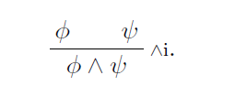
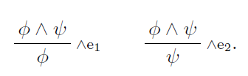
Natural deduction
Rules for conjunction

Slide 49

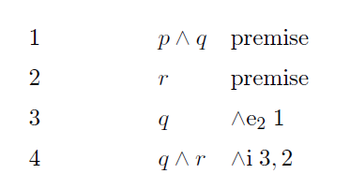
Natural deduction

Slide 50

Natural deduction
Rule of double negation

Slide 51
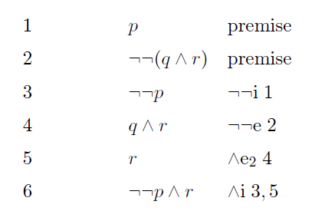
Natural deduction

Slide 52
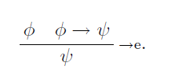

Natural deduction
Rule for eliminating implication

Slide 53
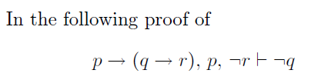
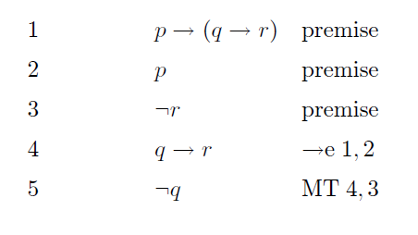
Natural deduction

Slide 54
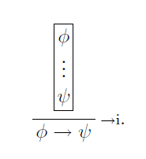
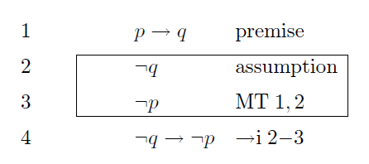
Natural deduction
Rule for implies introduction

Slide 55
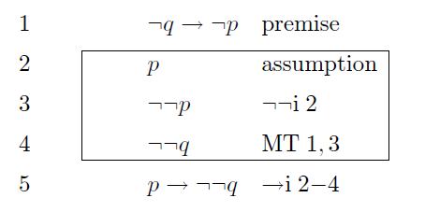
Natural deduction

Slide 56
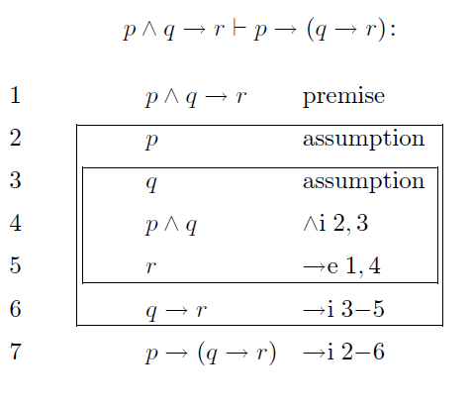
Natural deduction

Slide 57

Natural deduction
Rules for Disjunction

Slide 58
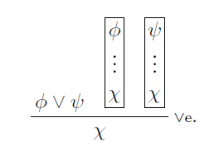
Natural deduction
Rules for Disjunction

Slide 59
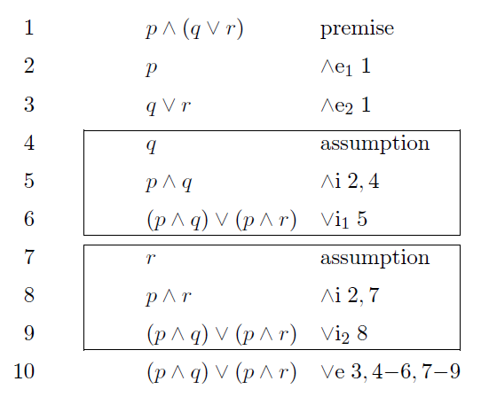
Natural deduction

Slide 60
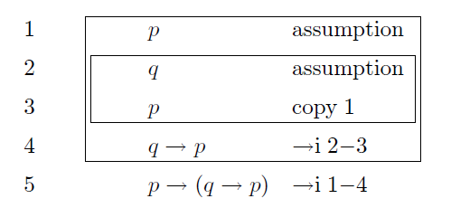
Natural deduction

Slide 61

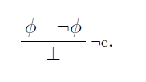
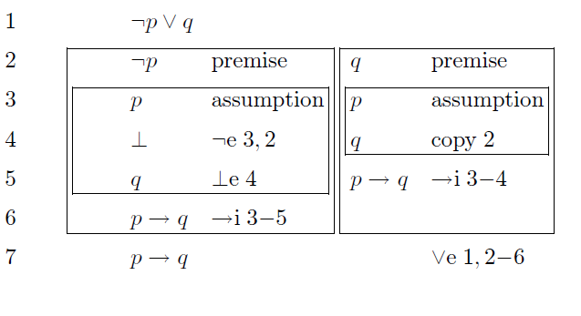
Natural deduction

Slide 62
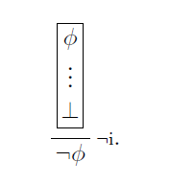

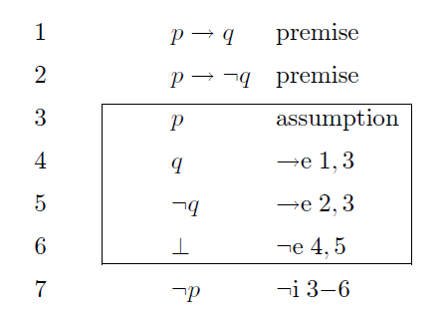
Natural deduction

Slide 63
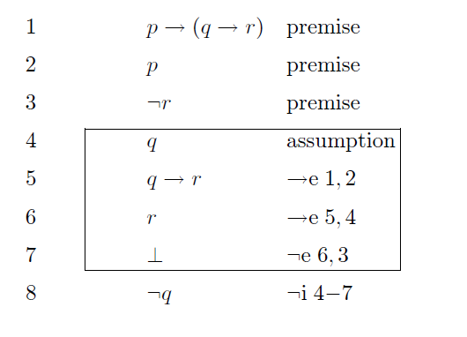
Natural deduction

Slide 64
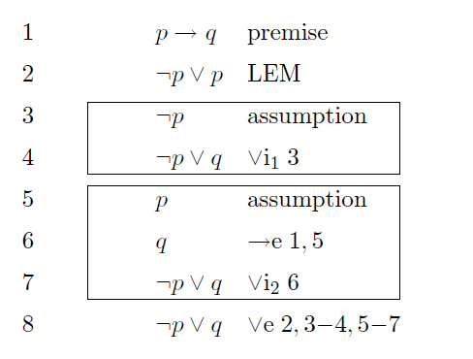
Natural deduction
Law of excluded middle (LEM)

Slide 65
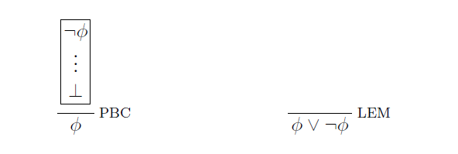
Natural deduction

Slide 66
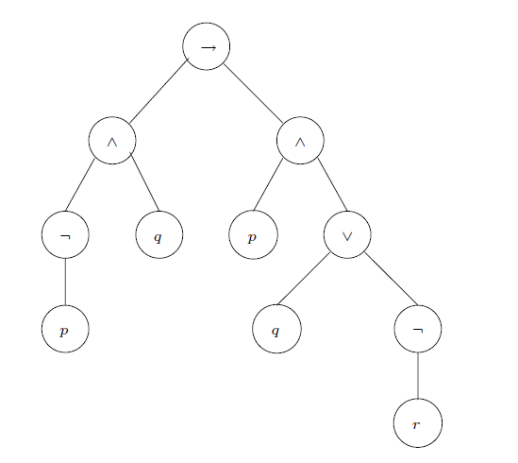
Parse Tree

Slide 67
Normal Forms
Negation Normal Form (NNF)
A formula is said to be in Negation Normal Form (NNF) if it only contains :, conjunction, disjunction and negation connectives and only atoms can be negated

Slide 68
Normal Forms
Disjunctive Normal Form (DNF)
A formula is said to be in Disjunctive Normal Form (DNF) if it is a disjunction of terms.

Slide 69
Normal Forms
Conjunctive Normal Form (CNF)
A formula is said to be in Conjunctive Normal Form (CNF) if it is a conjunction of clauses

Slide 70
Proposition properties
Validity
Satisfaction

Slide 71
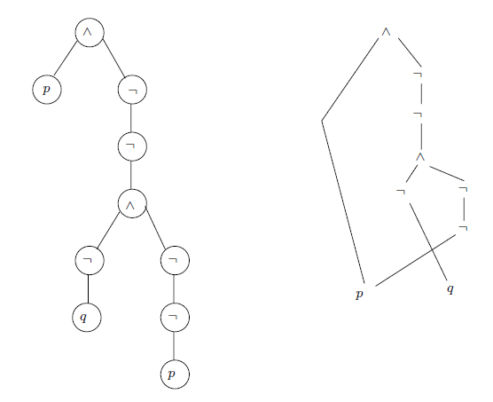
DAG

